Slide 1

Chapter 4:
Cluster Analysis in Data Mining
Notes:
‹#›

Slide 2
Density-Based, Grid-Based Clustering Methods
Objective
Understand density-based and grid-based clustering concepts.
Explore DBSCAN, a density-based clustering algorithm.
Learn about OPTICS, a density-based ordering approach.
Discover grid-based clustering methods, including STING and CLIQUE.
Recognize the benefits and applications of these techniques.
Let's dive into these methods that offer unique perspectives on clustering complex data.
‹#›

Slide 3
Density-Based, Grid-Based Clustering Methods
Density-Based and Grid-Based Clustering Methods
Density-based and grid-based clustering methods provide alternative approaches to grouping data points.
Density-Based Methods:
  Cluster data based on the density of data points.
  Identify dense regions separated by sparser areas.
  Robust to noise and can discover clusters of arbitrary shapes.
Grid-Based Methods:
  Divide the data space into a grid.
  Count data points in each grid cell to identify dense areas.
  Efficient for large datasets but may have limitations in handling complex shapes.
‹#›

Slide 4
Density-Based, Grid-Based Clustering Methods
Density-Based Clustering Methods
Clustering based on density (a local cluster criterion), such as density-connected points
Major features:
  Discover clusters of arbitrary shape
  Handle noise
  One scan (only examine the local region to justify density)
  Need density parameters as termination condition
‹#›

Slide 5
Density-Based, Grid-Based Clustering Methods
Density-Based Clustering Methods
Several interesting studies:
  DBSCAN: Ester, et al. (KDD’96)
  OPTICS: Ankerst, et al (SIGMOD’99)
  DENCLUE: Hinneburg & D. Keim (KDD’98)
  CLIQUE: Agrawal, et al. (SIGMOD’98) (also, grid-based)
‹#›

Slide 6
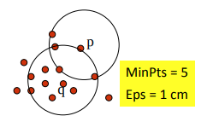
Density-Based, Grid-Based Clustering Methods
DBSCAN: Density-Based Spatial Clustering of Applications with Noise
DBSCAN is a density-based clustering algorithm that groups data points based on their density relationships.
DBSCAN (M. Ester, H.-P. Kriegel, J. Sander, and X. Xu, KDD’96)
  Discovers clusters of arbitrary shape: Density-Based Spatial Clustering of Applications with Noise
‹#›

Slide 7
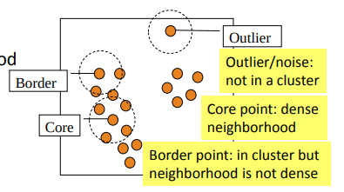
Density-Based, Grid-Based Clustering Methods
DBSCAN: Density-Based Spatial Clustering of Applications with Noise
A density-based notion of cluster
  A cluster is defined as a maximal set of density-connected points
Two parameters:
  Eps (ε): Maximum radius of the neighborhood
  MinPts: Minimum number of points in the
  Eps-neighborhood of a point
The Eps(ε)-neighborhood of a point q:
  NEps(q): {p belongs to D | dist(p, q) ≤ Eps}
‹#›

Slide 8
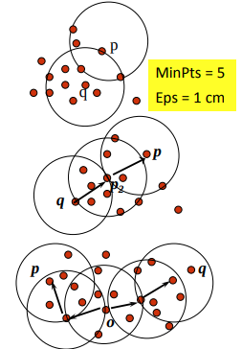
Density-Based, Grid-Based Clustering Methods
DBSCAN: Density-Reachable and Density-Connected
Directly density-reachable:
  A point p is directly density-reachable from a point q w.r.t. Eps (ε), MinPts if
    p belongs to NEps(q)
    core point condition: |NEps (q)| ≥ MinPts
‹#›

Slide 9
Density-Based, Grid-Based Clustering Methods
DBSCAN: Density-Reachable and Density-Connected
Density-reachable:
  A point p is density-reachable from a point q w.r.t. Eps, MinPts if there is a chain of points p1, …, pn, p1 = q, pn = p such that pi+1 is directly density-reachable from pi
Density-connected:
  A point p is density-connected to a point q w.r.t. Eps, MinPts if there is a point o such that both p and q are density-reachable from o w.r.t. Eps and MinPts
‹#›

Slide 10
Density-Based, Grid-Based Clustering Methods
DBSCAN: The Algorithm
Algorithm
  Arbitrarily select a point p
  Retrieve all points density-reachable from p w.r.t. Eps and MinPts
    If p is a core point, a cluster is formed
    If p is a border point, no points are density-reachable from p, and DBSCAN visits the next point of the database
  Continue the process until all of the points have been processed
‹#›

Slide 11
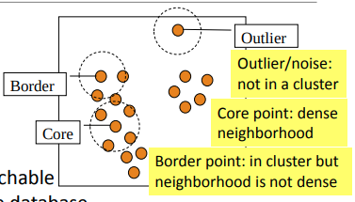
Density-Based, Grid-Based Clustering Methods
DBSCAN: The Algorithm
Computational complexity
  If a spatial index is used, the computational complexity of DBSCAN is O(nlogn), where n is the number of database objects
  Otherwise, the complexity is O(n2)
‹#›

Slide 12
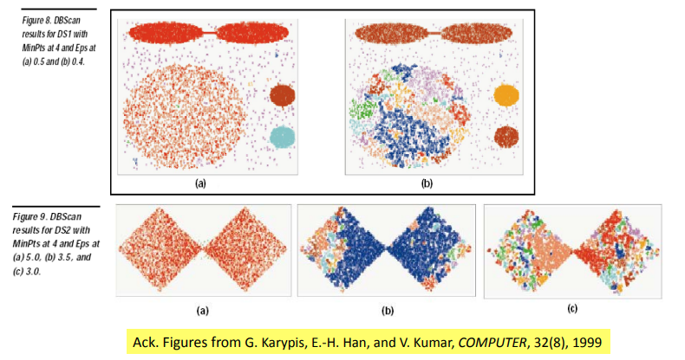
Density-Based, Grid-Based Clustering Methods
DBSCAN Is Sensitive to the Setting of Parameters
‹#›

Slide 13
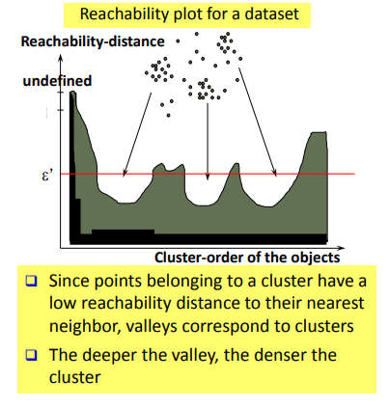
Density-Based, Grid-Based Clustering Methods
OPTICS: Ordering Points To Identify Clustering Structure
OPTICS (Ankerst, Breunig, Kriegel, and Sander, SIGMOD’99)
  DBSCAN is sensitive to parameter setting
  An extension: finding clustering structure
Observation: Given a MinPts, density-based clusters w.r.t. a higher density are completely contained in clusters w.r.t. to a lower density
‹#›

Slide 14
Density-Based, Grid-Based Clustering Methods
OPTICS: Ordering Points To Identify Clustering Structure
Idea: Higher density points should be processed first—find high-density clusters first
OPTICS stores such a clustering order using two pieces of information:
  Core distance and reachability distance
‹#›

Slide 15
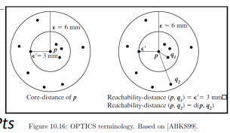
Density-Based, Grid-Based Clustering Methods
OPTICS: An Extension from DBSCAN
Core distance of an object p:
  The smallest value ε such that the ε-neighborhood of p has at least MinPts objects
  Let Nε(p): ε-neighborhood of p
  ε is a distance value Core-distanceε, MinPts(p) = Undefined if card(Nε(p)) < MinPts MinPts-distance(p), otherwise
‹#›

Slide 16
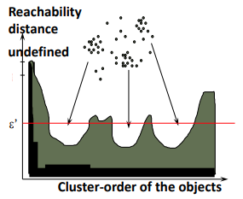
Density-Based, Grid-Based Clustering Methods
OPTICS: An Extension from DBSCAN
Reachability distance of object p from core object q is the min.
  radius value that makes p density-reachable from q
  Reachability-distanceε, MinPts(p, q) = Undefined, if q is not a core object max(core-distance(q), distance (q, p)), otherwise
Complexity: O(N logN) (if index-based) where N: # of points
‹#›

Slide 17
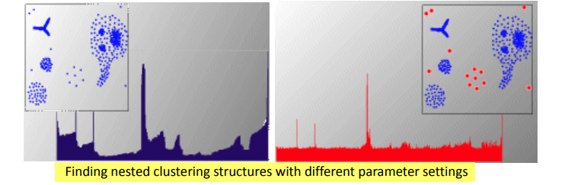
Density-Based, Grid-Based Clustering Methods
OPTICS: Finding Hierarchically Nested Clustering Structures
OPTICS produces a special cluster-ordering of the data points with respect to its density-based clustering structure
  The cluster-ordering contains information equivalent to the density-based clusterings corresponding to a broad range of parameter settings
  Good for both automatic and interactive cluster analysis—finding intrinsic, even hierarchically nested clustering structures
‹#›

Slide 18
Density-Based, Grid-Based Clustering Methods
Grid-Based Clustering Methods
Grid-Based Clustering: Explore multi-resolution grid data structure in clustering
  Partition the data space into a finite number of cells to form a grid structure
  Find clusters (dense regions) from the cells in the grid structure
Features and challenges of a typical grid-based algorithm
  Efficiency and scalability: # of cells << # of data points
  Uniformity: Uniform, hard to handle highly irregular data distributions
  Locality: Limited by predefined cell sizes, borders, and the density threshold
  Curse of dimensionality: Hard to cluster high-dimensional data
‹#›

Slide 19
Density-Based, Grid-Based Clustering Methods
Grid-Based Clustering Methods
Methods to be introduced
  STING (a STatistical INformation Grid approach) (Wang, Yang and Muntz, VLDB’97)
  CLIQUE (Agrawal, Gehrke, Gunopulos, and Raghavan, SIGMOD’98)
    Both grid-based and subspace clustering
‹#›

Slide 20
Density-Based, Grid-Based Clustering Methods
STING: A Statistical Information Grid Approach
STING is a grid-based clustering method that employs a statistical information approach.
STING (Statistical Information Grid) (Wang, Yang and Muntz, VLDB’97)
The spatial area is divided into rectangular cells at different levels of resolution, and these cells form a tree structure
A cell at a high level contains a number of smaller cells of the next lower level
‹#›

Slide 21
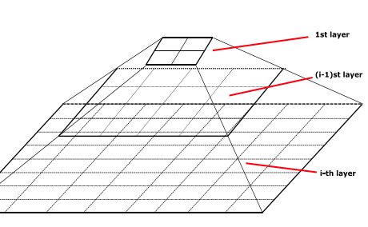
Density-Based, Grid-Based Clustering Methods
STING: A Statistical Information Grid Approach
Statistical information of each cell is calculated and stored beforehand and is used to answer queries
Parameters of higher level cells can be easily calculated from that of lower level cell, including
  count, mean, s(standard deviation), min, max
  type of distribution—normal, uniform, etc.
‹#›

Slide 22
Density-Based, Grid-Based Clustering Methods
Query Processing in STING and Its Analysis
To process a region query
  Start at the root and proceed to the next lower level, using the STING index
  Calculate the likelihood that a cell is relevant to the query at some confidence level using the statistical information of the cell
  Only children of likely relevant cells are recursively explored
  Repeat this process until the bottom layer is reached
‹#›

Slide 23
Density-Based, Grid-Based Clustering Methods
Query Processing in STING and Its Analysis
Advantages
  Query-independent, easy to parallelize, incremental update
  Efficiency: Complexity is O(K) K: # of grid cells at the lowest level, and K << N (i.e., # of data points)
Disadvantages
  Its probabilistic nature may imply a loss of accuracy in query processing
‹#›

Slide 24
Density-Based, Grid-Based Clustering Methods
CLIQUE: Grid-Based Subspace Clustering
CLIQUE is a density-based and grid-based subspace clustering algorithm
  Grid-based: It discretizes the data space through a grid and estimates the density by counting the number of points in a grid cell
  Density-based: A cluster is a maximal set of connected dense units in a subspace
    A unit is dense if the fraction of total data points contained in the unit exceeds the input model parameter
  Subspace clustering: A subspace cluster is a set of neighboring dense cells in an arbitrary subspace. It also discovers some minimal descriptions of the clusters
It automatically identifies subspaces of a high dimensional data space that allow better clustering than original space using the Apriori principle
‹#›

Slide 25
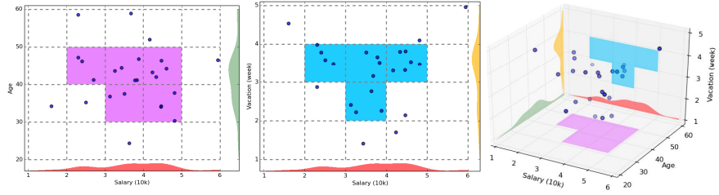
Density-Based, Grid-Based Clustering Methods
CLIQUE: SubSpace Clustering with Aprori Pruning
Start at 1-D space and discretize numerical intervals in each axis into grid
Find dense regions (clusters) in each subspace and generate their minimal descriptions
Use the dense regions to find promising candidates in 2-D space based on the Apriori principle
Repeat the above in level-wise manner in higher dimensional subspaces
‹#›

Slide 26
Density-Based, Grid-Based Clustering Methods
Major Steps of the CLIQUE Algorithm
Identify subspaces that contain clusters
  Partition the data space and find the number of points that lie inside each cell of the partition
  Identify the subspaces that contain clusters using the Apriori principle
Identify clusters
  Determine dense units in all subspaces of interests
  Determine connected dense units in all subspaces of interests
Generate minimal descriptions for the clusters
  Determine maximal regions that cover a cluster of connected dense units for each cluster
  Determine minimal cover for each cluster
‹#›

Slide 27
Density-Based, Grid-Based Clustering Methods
Additional Comments on CLIQUE
Strengths
  Automatically finds subspaces of the highest dimensionality as long as high density clusters exist in those subspaces
  Insensitive to the order of records in input and does not presume some canonical data distribution
  Scales linearly with the size of input and has good scalability as the number of dimensions in the data increases
Weaknesses
  As in all grid-based clustering approaches, the quality of the results crucially depends on the appropriate choice of the number and width of the partitions and grid cells
‹#›

Slide 28
Density-Based, Grid-Based Clustering Methods
Application: Spatial Data Analysis
Let's apply grid-based clustering methods to spatial data analysis.
Objective:
  Identify spatially dense regions in geographic datasets.
  Uncover clusters of high population density or frequent occurrences.
‹#›

Slide 29
Density-Based, Grid-Based Clustering Methods
Application: Spatial Data Analysis
Steps:
  Data Preparation: Collect and preprocess geographic data.
  Grid-Based Clustering: Apply STING or CLIQUE to identify dense regions.
  Cluster Interpretation: Analyze formed clusters for meaningful insights.
  Decision Support: Inform urban planning, resource allocation, or disaster response.
Grid-based clustering techniques contribute to better understanding and decision-making in spatial analysis.
‹#›

Slide 30
Density-Based, Grid-Based Clustering Methods
Comparison of Density-Based and Grid-Based Clustering
Density-Based:
  Focus on density relationships.
  Discover clusters of varying shapes and sizes.
  Robust to noise and outliers.
Grid-Based:
  Efficient for large datasets.
  Handle uniform and non-uniform distributions.
  May struggle with complex cluster shapes.
Choosing the appropriate method depends on data characteristics and analysis goals.
‹#›

Slide 31
Density-Based, Grid-Based Clustering Methods
Advantages and Considerations
Density-based and grid-based clustering methods offer distinct advantages and considerations.
Advantages:
  Density-Based: Suitable for irregularly shaped clusters and noise.
  Grid-Based: Efficient for large datasets and spatial analysis.
Considerations:
  Density-Based: Parameter sensitivity, especially for density thresholds.
  Grid-Based: May struggle with clusters of varying shapes and densities.
Choosing the right method requires understanding data nuances and the specific analysis objectives.
‹#›

Slide 32
Density-Based, Grid-Based Clustering Methods
Recap and Key Takeaways
DBSCAN leverages density relationships for cluster discovery.
OPTICS introduces a density-based ordering approach.
STING employs statistical information for grid-based clustering.
CLIQUE focuses on grid-based subspace clustering.
These methods enhance our ability to uncover clusters in diverse and complex datasets, opening new avenues for insights and applications.
‹#›

Slide 33
Summary
Density & Grid Clustering
Density-Based: Clusters by data density.
Grid-Based: Organizes data in grids.
Both effective for various datasets.
‹#›

